Slide 1

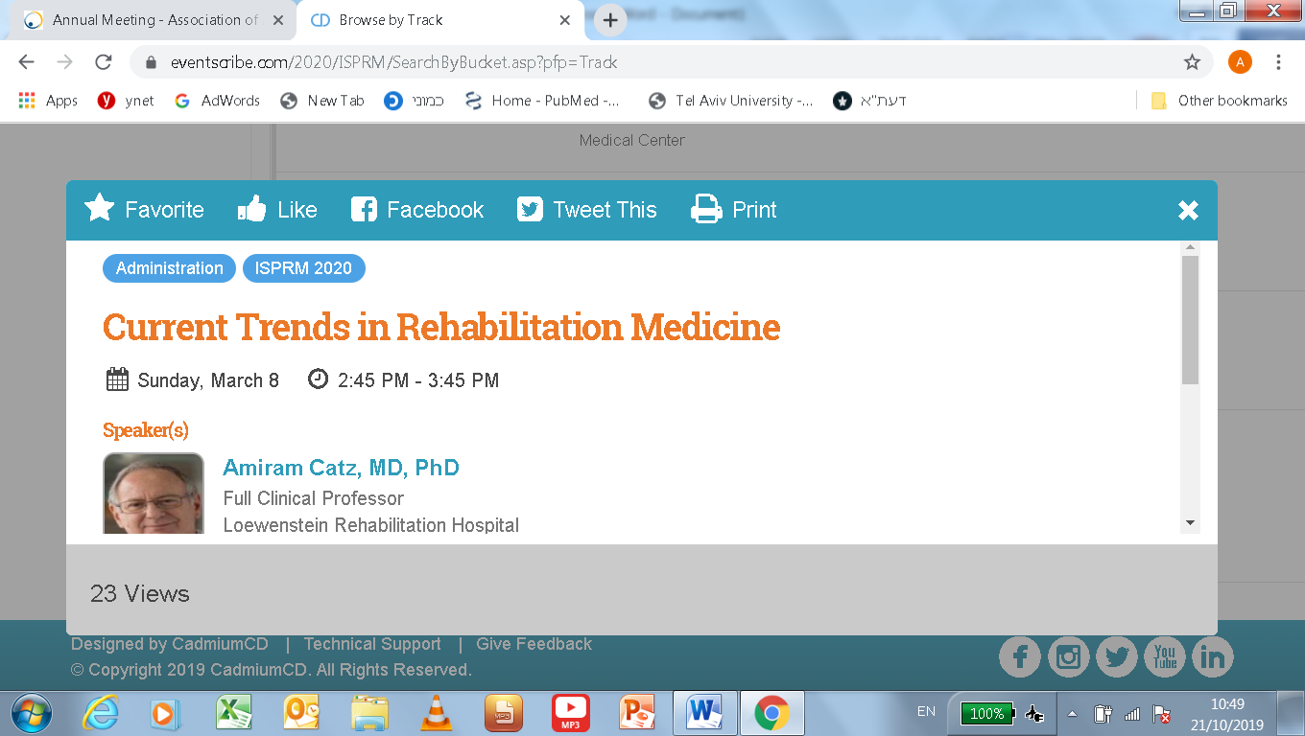



Critical analysis of fundamental concepts, approaches to outcome assessment, and evaluation of innovation
Prof. Amiram Catz, MD, PhD Dr. Dianne Michaeli, MD

Slide 2
Assessing ability realization
and the net effect of rehabilitation
Dr. Dianne Michaeli

Slide 3

Assessing the Net Effect of Rehabilitation
To promote the quality of rehabilitation, decisions must rely on quantitative assessment of:
the rehabilitative potential
the actual achievements of rehabilitation
Assessment of the effect of medical interventions is often challenging.

Slide 4


How to Effectively and Reliably Assess Achievements in Rehabilitation?
Antibiotics Cure
Rehabilitation ?

Slide 5


What Can We Measure in Rehabilitation?
Processes
E.g., the number of therapy sessions, duration of sessions, length of stay
Outcomes
E.g., function, muscle power, sensory deficit, cognitive impairment, movement velocity

Slide 6
What Affects Outcomes?
Outcomes are influenced not only by the above-mentioned factors but also by other factors over which we have no control, such as:
Age
Gender
Comorbidities
Mental state
Environmental factors

Slide 7
What Characterizes Measurements that Reflect the Achievements of Treatment?
Demonstrate the change in the patient’s outcome
Differentiate the contribution of treatment to the patient’s
condition in a certain domain from other affecting factors
Reflect the contribution of treatment to a patient or to a group of patients
in a department or hospital

Slide 8
How to Eliminate Factors Affecting Outcome other than Treatment?
Representing each measured value (a) as a fraction of its possible maximum (c) for a given affecting factor (b) enables us to isolate it from that affecting factor.
(aXb)
/
(cXb)
a/c
=

Slide 9
The spinal cord injury ability realization measurement index (SCI-ARMI)
is an instrument developed to measure the realization of the patient’s functional potential.
It is a measure for the assessment of disability, weighted for neurological deficit, in patients with spinal cord injury.
It measures how much of the maximum function possible with a specific neurological impairment the patient achieved.

Slide 10
The SCI-ARMI is calculated using the AMS and SCIM scores,
which are routinely collected in many spinal injury units worldwide.
AMS = ASIA (American Spinal Injury Association) Motor Score
(score range of 0-100) is used for quantitative assessment of motor status.
SCIM = Spinal Cord Independence Measure (score range of 0-100) is used for quantitative assessment of daily functioning.

Slide 11

SCIMho = the highest observed SCIM III score for a given
neurologic status.
SCIM95 = 95% of the patients with a given AMS achieve this or a lower SCIM score.
SCIMho = Capacity = SCIM95

Slide 12
SCIMob = the observed SCIM value, representing the observed functional value or the actual level of performance
SCIMob/SCIMho = Ability realization
SCI-ARMI = 100 X SCIMob/SCIMho

Slide 13
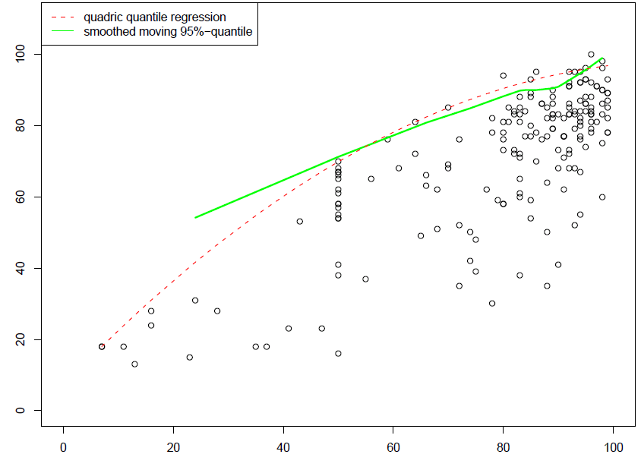
How to Determine SCIM95
To estimate SCIM95, we used the statistical software environment R, implementing the quantile regression method.
SCIM III
AMS
SCIM 95 = 7.045 − 0.007 * AMS² + 1.615 AMS

Slide 14
Dividing the observed SCIM III value by SCIM95 and
multiplying by 100 yielded the quadratic SCI-ARMI formula.
To include additional factors that may affect the ability realization, and to generalize the instrument for populations of various countries,
we collected data of 661 patients from Italy, Israel, USA, UK, Spain, and Portugal, and developed the international version of SCI-ARMI.
100 * SCIM III ob
SCI-ARMI = _____________________________________________
7.045 − 0.007 * AMS² + 1.615 * AMS

Slide 15
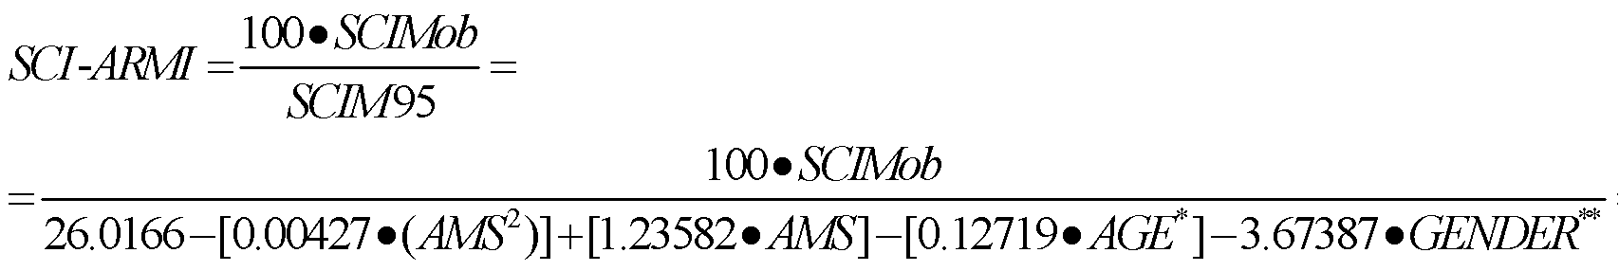
International Version of SCI-ARMI
Adding age and gender to the formula showed a statistically significant effect on SCIM95 (p<0.04) with any given AMS and age (p>0.16).
Adding country had no further effect.

Slide 16

The difference between admission and discharge SCI-ARMI values
= SCI-ARMI gain
This is the change in daily performance after controlling for
neurological recovery, age, and gender.
This is the net effect of rehabilitation
on the performance of daily activities

Slide 17
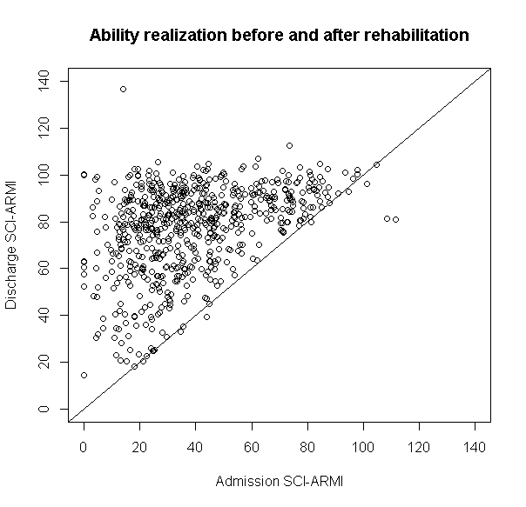
Discharge SCI-ARMI values were higher than admission values in almost all patients.
Average SCI-ARMI gain: 38.8 points
(SD=22, p<0.0001).
SCI-ARMI gain was positive, showing improvement in ability realization during rehabilitation.

Slide 18
This instrument enables accurate estimation of the effect of treatment, using known patient data (age, gender) and routinely collected data (SCIM III score, AMS).
Our findings support the validity of the instrument in an international setting.

Slide 19
To compute SCI-ARMI, you can enter an SCI patient’s SCIM III score, AMS, age, and gender in
http://www.scimscore.com

Slide 20
The difference between maximum ability realization and the admission SCI-ARMI value can be used to assess the potential benefit of rehabilitation.
SCI-ARMI = 20% The potential=80%
SCI-ARMI = 95% The potential=5%

Slide 21
SCI-ARMI and Beyond
SCI-ARMI is an instrument that assess the contribution of rehabilitation to patients’ improvement.
It can improve decision making and outcomes.
Applying this model to other measures can create additional tools for evaluating the achievements of rehabilitation and of interventional procedures.
It can be applied in various areas of rehabilitation medicine.

Slide 22
Discussion
In patients with incomplete spinal cord injuries, do you think that improvement in ability realization reflects the achievements of rehabilitation more than other measures do?

Slide 23
Discussion
What are your thoughts about using ability realization as a tool in decision making for the process of admission to rehabilitation and of discharge?

Slide 24
Discussion
Do you believe that the method described here for the assessment of ability realization can be used to develop tools that assess the effect of rehabilitation in patients with impairments other than spinal cord injuries?

Slide 25

Thank You

