Slide 1
Critical analysis of fundamental concepts, approaches to outcome assessment, and evaluation of innovation
Prof. Amiram Catz, MD, PhD Dr. Dianne Michaeli, MD

Slide 2
Critical analysis of recently published
effects of novel therapies
Prof. Amiram Catz, MD, PhD

Slide 3
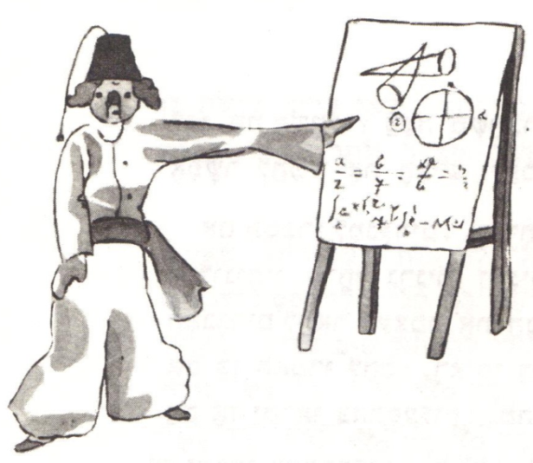
From the Little Prince
By Antoine de Saint-Exupéry
The planet from which the little prince came is the asteroid known as B-612.
This asteroid has only once been seen... That was by a Turkish astronomer, in 1909. On making his discovery, the astronomer had
presented it to the International Astronomical Congress.
But he was in Turkish costume, and so nobody would
believe what he said.
Grown-ups are like that...

Slide 4
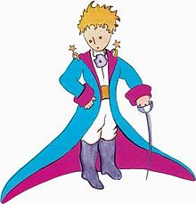
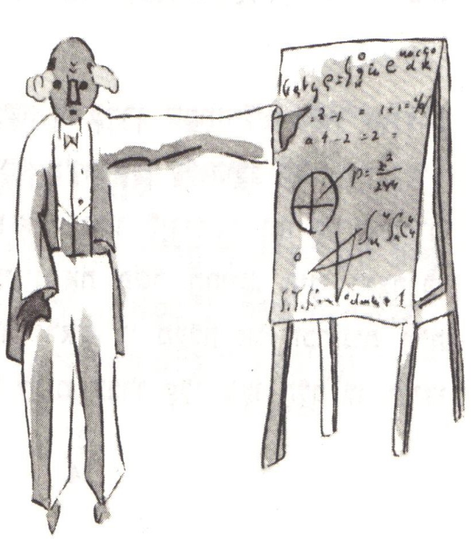
Fortunately, however, a Turkish dictator made a law that his subjects… should change to European costume.
So in 1920 the astronomer gave his demonstration all over again,
dressed with impressive style and elegance.
This time everybody accepted his report.

Slide 5
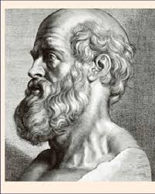
Scientific information is not necessarily more reliable when presented in distinguished clothing, by a distinguished author, or in a distinguished journal.
In the historical background of his book on spinal cord injuries (SCI),
Ludwig Guttmann mentions the novel treatment for SCI
recommended by Hippocrates, with ass’s milk, honey,
and white wine.

Slide 6
Two thousands and four hundred years after Hippocrates, in 2014, an editorial published in Brain, describes a combination of epidural electrical stimulation (EES) of the spinal cord and physical therapy, as “an example of successful translation of a neurobiological concept from basic neuroscience to clinical treatment.”

Slide 7
In 2018, an editorial of the most respected journal, Nature, describes a similar but more advanced treatment, as “an extraordinary development… that allowed the unprecedented restoration of walking ability.”
Hippocrates’s novel treatment did not prove efficient,
but at least did not cause harm.

Slide 8
EES, however, may be followed by severe complications in
30%-40% of the patients, including infection and abscess formation
(in 4%-10%), epidural hematoma, dural puncture, headache, neurological damage, and pain (Pain Medicine 2016; 17: 325-336).
Furthermore, the operation and rehabilitation offered to chronic SCI patients interrupts the continuity of their participation in their family and community activities, or work, nullifying long rehabilitation efforts that had been invested to achieve it.

Slide 9
So...
Is EES a breakthrough that justifies the risk of the untoward effects? Is it indeed a clinical breakthrough, or just one more step in the progress of spinal cord research?
To answer these questions,
I discuss the outcomes of the two prominent recent studies of EES for SCI, to which the editorials mentioned above refer:

Slide 10
The study of
Claudia A. Angeli, of the group of Susan J. Harkema, from the Frazier Rehab Institute, Louisville, Kentucky, USA, (Brain 2014: 137; 1394–1409)
and that of
Fabien B. Wagner, of the group of Grégoire Courtine, from the Swiss Federal Institute of Technology, Lausanne, Switzerland
(Nature 2018:563;65).

Slide 11
In Angeli’s study (2014),
EES with repeated trials to perform volitional movements, in legs without previous volitional movements
or electrophysiological
responses, achieved
non-functional volitional
movements that after further
training appeared even
without EES.

Slide 12
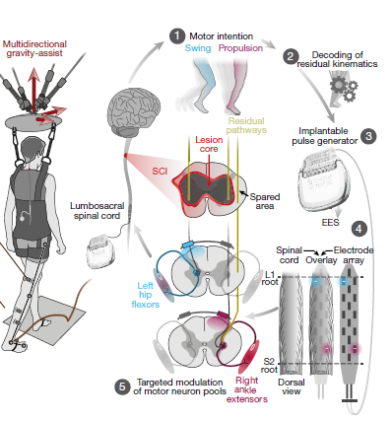
In Wagner’s study (2018),
EES directed to specific nerve roots,
combined with training for walking,
achieved volitional movements during ground
walking, in muscles that were previously
paralyzed, within a week with EES, and after
several months without EES.

Slide 13
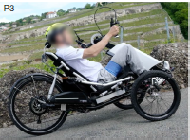
In Angeli’s study (2014), after the treatment, patients felt more
stable, pursued activities for longer periods of time, and reported less fatigue, but did not perform any task that they could not perform before the treatment.
In Wagner’s study (2018), after several months, the trained patients could also walk or cycle in ecological settings during EES.

Slide 14
Did the studies show neurological recovery ?
Despite the demonstration of certain neurological motor improvement, however, in Angeli’s study (2014), transcranial magnetic stimulation (TMS) could not elicit response in the legs after the treatment, which indicated
that the corticospinal tract did not recover.
Furthermore, Angeli considered recovery by sprouting unlikely, because of the early
execution of voluntary movement in 3 of 4 patients.

Slide 15
Wagner also did not attribute the clinical success to motor
tracts recovery, but to the preservation of proprioceptive transmission.
It seems that in both studies achieving voluntary movements did not
involve either neural regeneration or activation of damaged motor tracts.
Editorial commentary on these studies speculated, therefore, that EES and training activated silent residual descending proprioceptive tracts and commissural interneurons, which in turn, conveyed the cortical signals to the distal motor tracts.

Slide 16
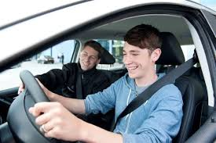
My opinion is that late activation of preserved nerves should not
be considered neurological recovery, just as achieving a new voluntary motor task by individuals with intact spinal cord after training is not considered neurological recovery.
These studies, therefore, did not demonstrate real
neurological recovery, but facilitated learning of motor tasks.

Slide 17
The theoretical explanations of the findings are consistent with
the fact that all the patients in these studies had incomplete SCI.
In Angeli’s study, sensation was preserved in half the patients, and all had intact autonomic cardiovascular responses.
In all of Wagner’s patients,
AIS grade was C or D.

Slide 18
In long-standing incomplete SCI, it may be difficult to distinguish volitional movements induced by new neural recovery from volitional movements induced by activation of nerves, which had recovered long before.
This raises the question: What could activate the volitional movements in these studies?

Slide 19
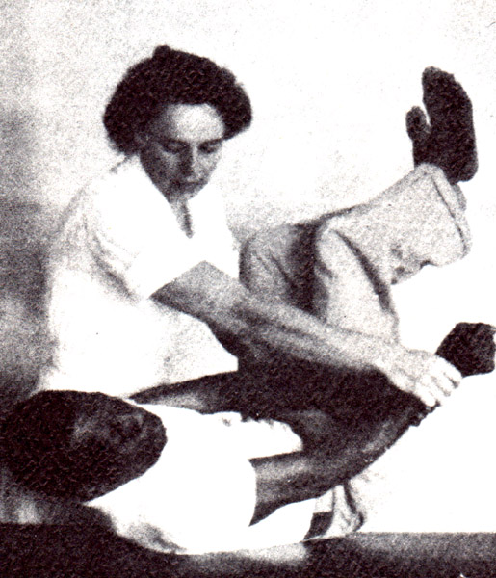
Did EES play a role in restoring voluntary movements?
This is uncertain because EES was followed by adding training to the training received before the EES, and no control group received similar additional training.
Moreover, achieving motor improvement by proprioceptive
facilitation, without EES, has been used in rehabilitation since
the late 1930s, when Kabat and Knott began using PNF in CP.
"Maggie" Knott,
pioneer physical therapist

Slide 20
Achieving motor improvement by proprioceptive facilitation
is not a novel concept, and does not require EES.
It is possible, therefore, that it was rehabilitation that uncovered the new volitional movements, and not EES.

Slide 21
Did EES make a significant contribution
to functional improvement?
The restored voluntary movements made only a minor contribution
to daily activities.
Angeli’s article did not describe any functional mobility after the treatment.

Slide 22
In Wagner’s study, in 2 of 3 patients the
strength of hip and knee muscles, which
could not overcome
gravity before the
EES, was insufficient,
or hardly sufficient
to overcome gravity after the treatment. In these patients, the improvement in muscle strength could not have contributed, or hardly contributed to functional walking.
Wagner 2018
Extended Data Table 1
Rt/Lt

Slide 23
Wagner 2018
Extended Data Table 1
The 3rd patient, whose hip and knee muscle
strength improved from 0-2/5 to 2-4/5, was
a 28 y old man,
with a WISCI II score
of 13 before the treatment. This score means that he could walk 10 m with a walker, without assistance or braces, before the treatment.
Rt/Lt
WISCI II Levels

Slide 24
The paper did not explain how he could walk
with a walker, without assistance or braces,
with a muscle strength of 0-2/5, which is not
sufficient to
overcome gravity.
After the treatment, however, he achieved a WISCI II score of 16, which means that he replaced the walker with two crutches.
Wagner 2018
Extended Data Table 1
Rt/Lt
WISCI II Levels

Slide 25
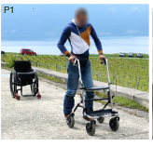
He even achieved ground walking with EES, but the figure demonstrating it in an ecological setting, shows that this walking required a walker, just as before the treatment, and also a wheelchair behind…
WISCI II Levels
Nature 2018:563;65 Figure 6b

Slide 26
With additional rehabilitation alone, using braces and crutches, he could have been walking, swinging with a functional speed, and maybe climbing stairs. This type of mobility may be more functional than that seen in the picture.

Slide 27
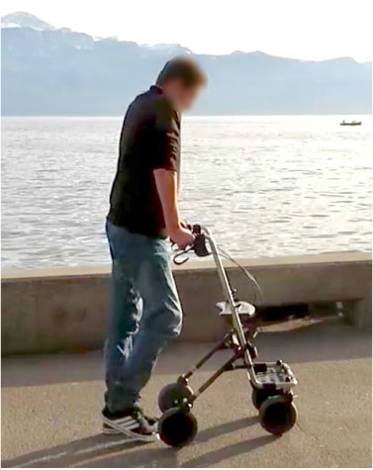
This and one other patient demonstrated
ground walking after the treatment.
The second patient,
a 35 y old male,
achieved walking with a walker, without braces and assistance,
instead of using a walker with braces and assistance.
His WISCI II score increased from 6 to 13.
Using EES he could walk with a walker, without assistance
or braces, even in an ecological setting.
Wagner 2018
Extended Data Table 1
Rt/Lt
Rt/Lt
Nature 2018:563;65
Figure 6b

Slide 28
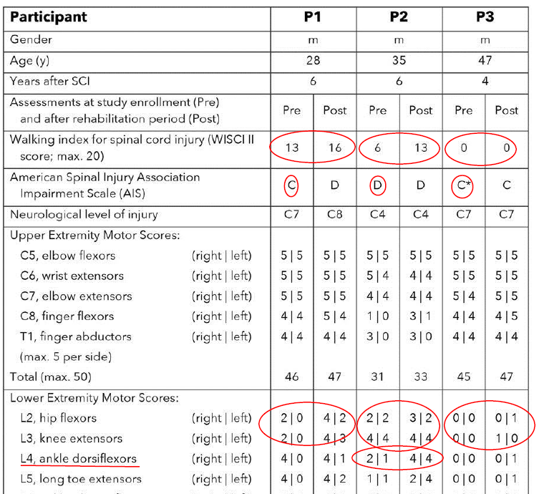
His main restored voluntary
movements were those of ankle dorsiflexion, which contributed to eliminating the need for short leg braces.
Elimination of the need for short leg braces was his only functional gain.
This patient, however, had a muscle
strength of 4/5 in the knee and elbow extensors before the treatment.

Slide 29
With a muscle strength of
4/5 in the knee and elbow extensors, good rehabilitation, and some adaptation for gripping the walker, he should have probably achieve walking without assistance, avoiding the replacement of short leg braces with EES. The mobility he could probably have achieved is as functional as that seen in the picture.

Slide 30
To conclude:
Studies of EES did not prove real neurological recovery;
The role of EES in restoring voluntary movements is uncertain; and
The clinical achievements in these studies did not surpass those that can be achieved by rehabilitation alone.

Slide 31
The results of these studies, therefore, are not a breakthrough yet, and have limited clinical value at present.
Using EES for SCI is justified only within a research setting,
and not in clinical practice.

Slide 32
The above arguments are not intended to devalue the
importance of the elegant and thorough research described in the reviewed articles. What they show is that these publications did not demonstrate clinical breakthroughs but important steps in the progress of spinal cord research.
Future developments, combining EES with brain computer interface (BCI) and rehabilitation may prove a treatment option of greater clinical significance, without additional risk.

Slide 33
Our arguments are presented to stress the importance of
critical analysis of publications on novel developments for patients in rehabilitation, using knowledge customarily used in rehabilitation medicine.
Respected researchers and distinguished journals may underestimate side effects of interventions and the possible contribution of rehabilitation to functioning, and arrive at premature conclusions, which may cause patients to interrupt the continuity of rehabilitation or its achievements.

Slide 34
We should carefully analyze publications on novel treatments, not to be led astray by the wrong trends in medicine. Instead, we must guide our staff and patients to choose treatments and activities that are expected to achieve the best outcomes.

Slide 35
Discussion
How many of you agree that we should use rehabilitation skills in analyzing publications about novel treatments, developed for patients in rehabilitation, to be able to guide staff and patients to choose treatments and activities expected to achieve the best outcomes?

Slide 36
Discussion
2. How many of you agree that using EES for SCI is justified only within a
research setting, and not in clinical practice?

Slide 37
Discussion
3. How many of you believe that the studies of EES did not prove real neurological recovery, and that the role of EES in restoring voluntary movements is uncertain?

Slide 38
Discussion
4. Who is willing to comment on the desired approach to publications on novel therapies?

Slide 39
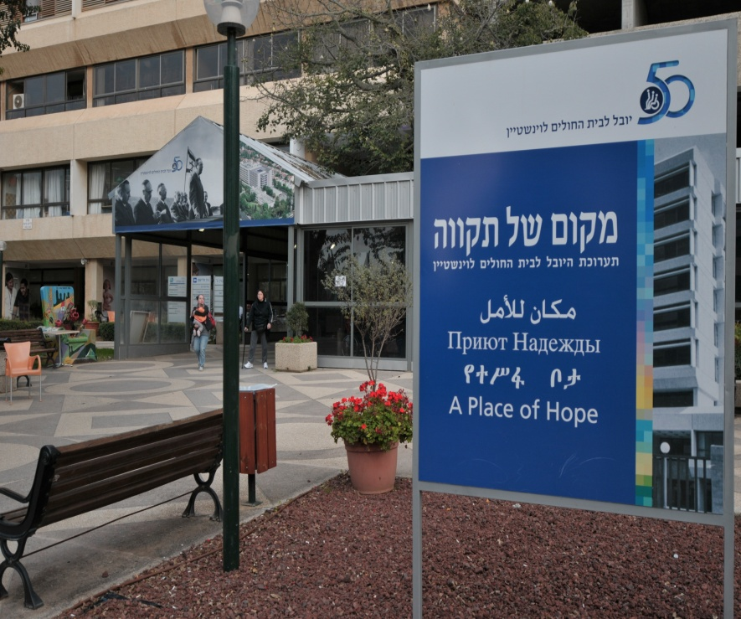
!Thank You

