Slide 1
Critical analysis of fundamental concepts, approaches to outcome assessment, and evaluation of innovation
Prof. Amiram Catz, MD, PhD Dr. Dianne Michaeli, MD

Slide 2
LOEWENSTEIN
HOSPITAL
REHABILITATION CENTER

Slide 3
Critical analysis of fundamental concepts
in rehabilitation Medicine
Prof. Amiram Catz, MD, PhD

Slide 4
Further expanding the horizon of medicine
Rehabilitation, which is a relatively new medical profession, introduced a new medical concept:
Medical intervention can improve patients’ health and social involvement, irrespective of the ability to cure the basic impairment that caused the disability, or of the success in treating the impairment.

Slide 5
The new approach has expanded the horizon of medicine, and brought about new human achievements.
To follow a path of continued improvement in these achievements, however, we suggest several changes in trending practices, based on concepts reflected in the strategic goals of rehabilitation medicine.

Slide 6
The role of strategic goal setting
The evidence that goal setting can improve rehabilitation outcomes is of low quality (WMM Levack. Cochrane Database of Systematic Reviews 2015, Issue 7, Art CD009727).
In organizational settings, however, it has been shown that setting difficult goals leads to high performance, presumably through increased motivation (EA Locke, GP Latham. American Psychologist 2002;57:705-717).

Slide 7
Derick Wade concluded, therefore, that there is no reason
to doubt the effectiveness of setting specific goals in rehabilitation (DT Wade. Clinical Rehabilitation 2009;23:291–295).
It is reasonable to assume that rehabilitation staff members will invest greater effort to achieve strategic, meaningful, agreed-upon, realistic, and timely (SMART) goals.

Slide 8
Rehabilitation outcomes, however, quite likely depend on the nature of the goals.
Setting SMART goals, which are expected to make a relatively higher contribution to the patient’s interests, are likely to result in better rehabilitation outcomes.

Slide 9
We propose that:
Prolonged survival should be treated as a main rehabilitation goal, contrary to the opinions of most authors on rehabilitation.
Rehabilitation should aim at achieving maximum ability realization, rather than independence, any functioning, or prior functioning.
Rehabilitation goals should be set based on their benefit to the patient, rather than to the caregiver or the insurer.

Slide 10
Training should focus on tasks that contribute primarily to the patients' interests and conform to the patients' desires, rather than on any task that reduce the burden of care.
The main criterion for admission to a rehabilitation ward should be its expected advantage over other facilities in prolonging patient survival and maximizing ability realization.

Slide 11
The first change we propose is:
Defining longevity as a strategic rehabilitation goal
Various official documents, which set goals for medical interventions, emphasized the physician’s duty to respect or save human life.
These include:
Several versions of the Oath of Hippocrates, since the 5th century BC
The declaration of Geneva of the World Medical Association (1983)
Modern Hippocratic Oaths
The Muslim Qur'an
The Oath of the Hebrew Physician (Jerusalem, 1952)

Slide 12
Documents that define goals for rehabilitation, however, explicitly or implicitly presume that rehabilitation starts after the cure process is completed. Consequently, most goal definitions in rehabilitation include improvement of function and quality of life (QOL), but not longevity.
This has been true for the definitions provided by many authors, for decades.

Slide 13
Ludwig Guttmann defined the goal of the center he founded at Stoke-Mandeville, UK, at 1944, “To rescue these men and women from the human scrap-heap and return most of them, in spite of their profound disability, to the community as useful and respected citizens” (L Guttmann. Spinal Cord Injuries, 1973).

Slide 14
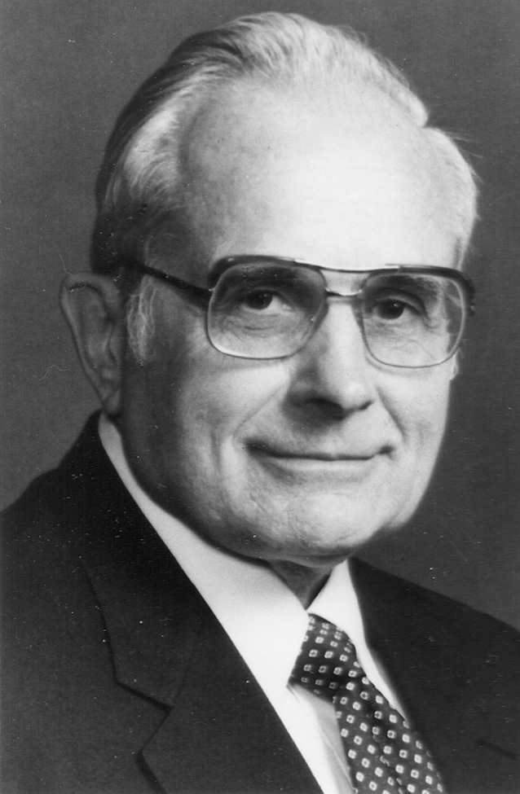
Kottke, 1982 (pref. XIV):
“Outcome should be measured by parameters of patient
performance throughout life, rather than by length of survival.”
DeLisa, 1993 (3):
“Anticipated patient outcomes of such a comprehensive and integrated rehabilitation program should include increased independence, a shortened length of stay, and an improved quality of life.”

Slide 15
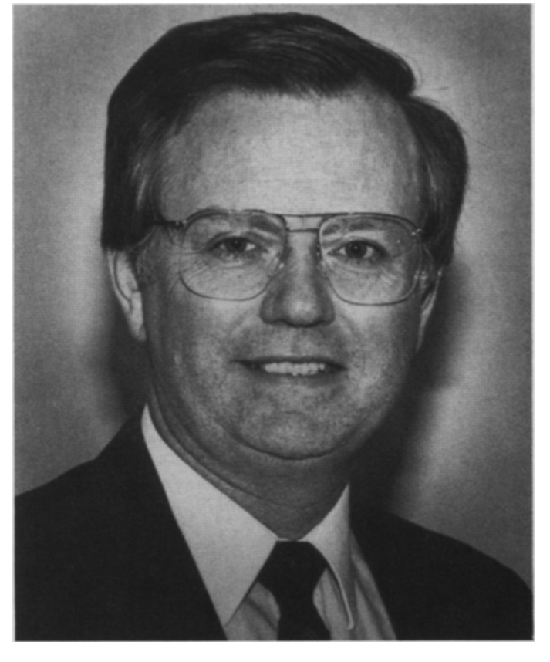
Bradom, 1996 (239):
“...an important purpose of medical rehabilitation is to improve the functional status of patients...”
DeLisa, 2005 (pref. XVII):
“Physical Medicine and Rehabilitation focuses on the
restoration of function and reintegration into the community.”

Slide 16
S. Sunder Textbook of Rehabilitation, 2010 (Chennai, India):
“The role of rehabilitation is to minimize disability and handicap.”
“The role of medical rehabilitation is to limit disability.”
“The role of socio-vocational rehabilitation is to limit handicap.”

Slide 17
World report on disability by the WHO, 2011 (article 26, Habilitation and Rehabilitation, of the United Nations Convention on the Rights of Persons with Disabilities, CRPD) calls for:
“…appropriate measures, including through peer support, to enable persons with disabilities to attain and maintain their maximum independence, full physical, mental, social and vocational ability, and full inclusion and participation in all aspects of life.”

Slide 18
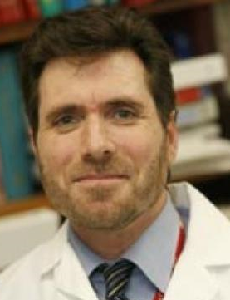
Maitin & Cruz, 2015:
“In PM&R we emphasize functional improvement, and strive to maximize independence, quality of life, mobility, and function.”

Slide 19
Survival and prevention of morbidity, however, are necessary
for optimal functioning.
Improvement of functioning can assist in reducing medical complications and increase life expectancy.
Survival and complications on one hand, and functioning on the other, have mutual effects.

Slide 20
This is obvious after spinal cord injuries.
SCIM and FIM scores 6 months and 5 years after discharge from rehabilitation, were lower in patients with medical complications during acute admission
(J Blessing. J Neurotrauma 2019;21:3044-3050. M A Kopp, Neurology 2017;88:892–900).
FIM score at discharge from rehabilitation was found to be an independent risk factor for hospitalization (JT Cohen. Spinal Cord;2012: 50, 728–733) and reduced survival after SCI (BB Hatch et al. Spinal Cord;2017:55, 540–544).

Slide 21
The same was demonstrated following a stroke.
Patients with more complications (VTE, UTI, pneumonia, pressure sores, and other) showed lower FIM scores from the time of discharge to 12 months after stroke onset (BR Kim et al. Ann Rehabil Med 2017;41:753-760).
The 3-month disability, assessed with the MRS score, was an independent predictor of survival in stroke patients (H Ting Chiu et al. Phys Med Rehabil 2012;93:527-31).

Slide 22
The same was evident after traumatic brain injury as well.
Comorbidities independently predicted disability (assessed with the Disability Rating Scale - DRS) (E Gardizi, Archives of Physical Medicine and Rehabilitation 2014;95:2396-2401).
Disability (assessed with FIM or DRS) is an independent predictor of survival (JC. Brooks, Archives of Physical Medicine and Rehabilitation 2013;94:2203-2209).

Slide 23
Prevention of medical complications and comorbidities helps
improve functioning during rehabilitation, and improved functioning increases survival rate.
Defining longevity as a strategic rehabilitation goal, therefore, is expected to motivate rehabilitation staff members to invest greater effort, knowledge, and skill into preventing complications, thereby improving both survival and functioning.

Slide 24
The second change we propose is:
Defining maximum ability realization
as a strategic rehabilitation goal
Goal setting motivates patients and staff to achieve the goal. Therefore, if the goal set for rehabilitation is below the patient’s ability, patient and staff may not try to achieve the maximum that patient ability allows, and rehabilitation achievements will probably be lower than they could be.

Slide 25
If the goal set for rehabilitation is above the patient’s ability, and it is not realistic, patient and staff may give up trying to achieve it, lose the goal-directed behavior, or become frustrated after wasting fruitless time and effort.
If a goal set for rehabilitation is the maximum that patient ability allows, patient and staff are likely to try to achieve this goal, and achievements will probably be the highest that can be.

Slide 26
Setting such goals as independence, any functioning, or prior functioning may direct patients and staff below or above what patient ability allows, and achievements will probably be lower than they could be.
Patients who could be walking, may achieve independence in a wheelchair. They may improve functioning, but less than possible. They may strive for prior functioning, even if it is much less than possible, or unrealistic.

Slide 27
To achieve optimal functioning, therefore, rehabilitation should
aim at achieving maximum ability realization.
Estimating ability and assessing ability realization is the topic of the next presentation, by Dr. Dianne Michaeli.

Slide 28
The third change we propose is:
Setting rehabilitation goals that contribute mainly to the patient’s benefit
Striving for ability realization can maximize the functional achievements of rehabilitation, but the value of the functions achieved depends on their benefit to the patient. The benefit to the patient must always underlie medical achievements, but current trends in rehabilitation are sometimes beneficial to caregivers or insurers, rather than to patients.

Slide 29
Favoring the concept that rehabilitation goals should contribute mainly to the patient’s benefit, we must:
Choose goals that match the patient’s interests and desires
Include in the functional assessment maximum tasks and task versions of value for the patient
Assign measurable weights to tasks, which allow ranking their value

Slide 30
Choosing goals that match the patient’s interests and desires
(benefitting the patient)
Reducing the burden of care is frequently a strategic goal of rehabilitation.
A lower burden of care is closely related to patient independence, which may be an interest of the patient, but it is not always the patient’s interest, and it is usually the interest of the caregiver and of the insurer.

Slide 31
For example:
The burden of care may be similar for patients who can go a certain distance using a wheelchair or walking. If the main goal is to reduce the burden of care, insufficient efforts may be invested in achieving walking.
The burden of care required for a patient with an indwelling catheter may be smaller to that required for a patient on intermittent catheterization. If the main goal is to reduce the burden of care, insufficient efforts may be invested in weaning from an indwelling catheter.

Slide 32
Decreasing the burden of care may compromise patient desires or health. It may prevent desired possible walking, or increase the risk of urinary infection.
Independence is important for most people, but not for all patients, not for all families, and not in every culture.

Slide 33
Therefore, we must choose functional goals that include
independence, match the patient’s desires, and contribute to health and longevity. We must find the proper balance between these, for every patient.
For example:
The maximum independence possible with a desired realistic mobility
The maximum independence possible with safe and comfortable bladder management

Slide 34
Including maximum tasks and task versions of value for the
patient in the functional assessment (for the patient’s benefit)
To improve the current performance of a certain task, we must assess the performance and close the gap between it and the functional potential of that task. To improve the performance of task versions with maximum patient benefit, therefore, we must include them in the functional assessment, and not be content with assessment of other tasks that may require similar abilities.

Slide 35
Examples of task versions that should be included, but are
frequently missing from functional assessments:
Management of respiration, for patients who have respiratory difficulty
Patient activity to prevent pressure sores
Car-wheelchair and ground-wheelchair transfers
Management that enables sufficient bladder filling and emptying
Outdoor mobility
Assessing such tasks can improve functioning that benefits patients

Slide 36
Assigning measurable weights to the tasks
(for the patient’s benefit)
To allow ranking the value of each task, and direct training aimed at tasks that have greater value or greater potential for improvement, we must assign measurable weights to each task.
The weights of tasks may vary for different types of impairment. Sphincter management should probably be assigned a relatively high weight for SCI patients, and problem solving for patients with brain lesions.

Slide 37
Criteria that define functioning that is more beneficial for the patient should be weighted higher.
For example:
Independent mobility should be weighted and scored higher, when the patient is walking with crutches for a certain distance, than using a wheelchair for the same distance.
Independence in bladder management should be weighted and scored higher when filling volume is high and residual volume is low.

Slide 38
The fourth change we propose is: Focusing training on tasks that contribute primarily to patients' interest and desires
To enhance patient-oriented outcomes, training should focus on tasks that contribute primarily to patients’ benefit, rather than on any task that reduces the burden of care.

Slide 39
It may be easier, faster, and cheaper to achieve wheelchair independence, or indwelling catheter voiding, than walking or voiding using intermittent catheterization.
But caregivers should focus on walking and intermittent catheterization, when these are achievable and correspond with patients’ interest and desires.

Slide 40
The fifth change we propose is:
Admission to rehabilitation based on expected advantage in prolonging survival and maximizing ability realization
The criteria for admission to a rehabilitation facility
reflect the resources, the expected achievements,
the advantages, and the disadvantages of that facility.

Slide 41
The main advantage of a physician, a department, or an institute specializing in rehabilitation medicine over other medical specialists, departments, or institutes, is the unique ability to prolong survival and maximize the ability realization of patients with disability.

Slide 42
If this advantage is not included in the definition of the criteria for rehabilitation, members of the general public and stakeholders cannot see a clear difference between the specialized rehabilitation ward and a nursing home. Therefore, they will not increase investment in specialized rehabilitation, and the outcome of specialized rehabilitation will be fated to remain limited and lower than it could be.

Slide 43
Wards and institutions have defined various admission criteria:
Among these are:
Potential to achieve significant or any measure of independence
Potential for functional improvement
Potential to achieve specific functions
Potential to achieve a previous functional level
Need for the care of a multidisciplinary team
Need for intensive therapy
Being after an event, such as surgery, stroke, SCI, etc.

Slide 44
We see such definitions in publications and on the websites of various institutions.
Richard G. Stefanacci
Annals of Long-Term Care: Clinical Care and aging 2015;23:18:
“Acute inpatient rehabilitation services are available for patients requiring acute rehabilitation, defined as restoration of a disabled person to self-sufficiency or maximal possible functional independence.”

Slide 45
Medicare (Website):
Your doctor may send you to an inpatient rehabilitation facility if you are recovering from major surgery such as bilateral hip replacement or a serious injury or illness such as a stroke or spinal cord injury and you require a team of medical professionals and intensive therapy to help you recover.

Slide 46
Good Shepherd Rehab network (Website):
For inpatient admission, patient must
• Require multiple therapy disciplines
• Require a 3h/day, 5 days/week program
• Be able to actively participate in the program
• Require the supervision of a physiatrist
• Be expected to make measurable improvement

Slide 47
Kessler Rehabilitation Center (Website):
Why should I choose acute rehabilitation?
An acute rehabilitation hospital, like Kessler, offers patients a more specialized and intensive program than those available at nursing homes. As a result, patients generally achieve better outcomes and enjoy great independence.

Slide 48
None of the frequently used criteria, however, show an obvious difference between specialized rehabilitation medicine and the use of rehabilitation elements in a nursing home. With a relatively small investment, nursing homes can employ professionals who can be described as a multidisciplinary team, and can treat patients after medical events intensively. They may even employ a physiatrist to supervise the professionals.

Slide 49
But this does not make them specialized rehabilitation wards.
Only the presence of a critical mass of physiatrists who can lead a specialized team to achieving maximal survival and ability realization makes a ward a specialized rehabilitation ward, and makes a clear difference between such a ward and a well-furnished nursing home.

Slide 50
These physicians must have knowledge and experience in preventing the complications of the specific injuries and diseases of the patients who require rehabilitation, and in assessing both actual and potential function, for each type of impairment, for each severity.
The multidisciplinary teams must have the knowledge and experience required to translate the physicians’ knowledge and experience into care that maximizes survival and ability realization.

Slide 51
Inclusion of the expected advantage of a facility in prolonging the survival and maximizing the ability realization of persons with disability among the inclusion criteria of rehabilitation wards creates a commitment to leveraging that advantage; makes the distinction between specialized and non-specialized rehabilitation; and may increase investments in specialized rehabilitation, contributing to improved rehabilitation outcomes.

Slide 52
Conclusion
Yes, we can!
We can improve rehabilitation outcomes by defining prolonged survival and maximum ability realization as main rehabilitation goals; by including the potential to achieve these goals in the criteria for admission to rehabilitation; and by focusing rehabilitation goals and training on their benefit for patients and on the patients’ desires.

Slide 53
Discussion
Several statements in this presentation may be controversial.
I believe that the suggested changes can improve rehabilitation outcomes, but there are no data to prove it directly. I welcome, therefore, cooperation in studies that would examine these suggestions.
How many of you agree that prolonging life should be a strategic rehabilitation goal?

Slide 54
Discussion
2. We will discuss ability realization after the next presentation.
How many of you agree that rehabilitation goals and training should be set based on their benefit for the patient, rather than merely on reducing the burden of care?

Slide 55
Discussion
3. How many of you agree that including the potential to achieve prolonged survival and maximum ability realization among the criteria for admission to rehabilitation can improve rehabilitation outcomes?

Slide 56
Discussion
4. Who is willing to comment on the suggested changes?

Slide 57
!Thank You

